Slide 1
CSCI 4050U
Machine Learning Final Project
Connor Robertson
Terry Darmawan Hosea
Manmeet Choudhary

Slide 2
Description of Problem
The post pandemic world relies heavily on members of society doing their part to help make world safer by taking simple precautions, such as using a mask to cover their face. However, enforcing simple procedures can require unnecessary man-power, especially since machine learning can easily solve these problems.
Identifying masked and maskless people solves the problem of maskless people entering establishments where they are not permitted. Especially in cases where the volume of people entering the establishment is too high for one person to accurately identify everyone not following proper procedures
Notes:
New

Slide 3
Description of Data
Identifying whether the face in a picture has a mask, no mask, or mask is improperly worn. The model will be trained against pictures of a face with a mask, without a mask, and a face with mask improperly worn.
The data that is used to train and test the model is collected within the program itself by having a webcam take multiple pictures of a person’s face with a mask on. This process is then repeated for pictures of a person’s face without a mask, and mask that is improperly worn.
The program then further crops the image by using Haar Cascade to focus specifically on the face of the person to build the dataset
The model is then trained on that dataset with the following categories: masked, no mask, and improperly worn mask.

Slide 4

CNN (Convolutional Neural Network)
CNN, or ConvNet is a machine learning algorithm that takes an image as input. Then it convolves that input through different hidden layers until it can classify what is in the image correctly. CNN is able to capture spatial information by using a kernel to compare it against the input image. Then using a pooling layer, to extract dominant features from the image.

Slide 5
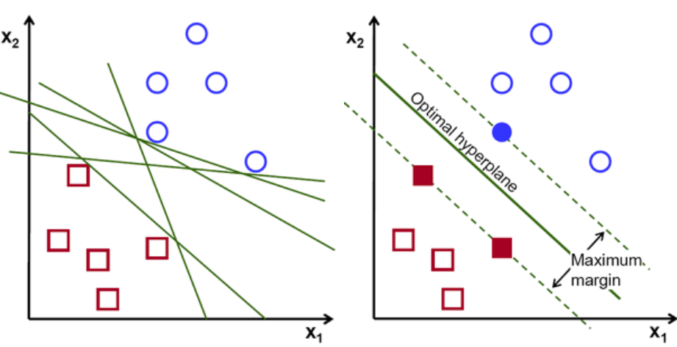
SVM (Support Vector Machine)
SVM is a supervised machine learning algorithm, which can be used for classification and regression problems. The algorithm will generate a hyperplane(s) which separates the data into classes.
SVM will compute and maximize the distance between the hyperplane and the data points. Like the image to the right

Slide 6
Description of Design
A CNN model was originally developed to differentiate between images of people with or without masks, however in a live test , the accuracy would drop in regards to a person wearing an improper mask (i.e not covering nose or mouth) and someone wearing a mask properly.
Thus an SVM model was implemented in efforts to increase accuracy during live test. While still not achieving complete accuracy, the SVM model did increase the accuracy of correct prediction during the live test even when the person in front of the camera was fidgeting with their mask.

Slide 7
Description of Implementation
COVID-19 has greatly affected the importance of properly worn masks. The benefits of having a computer identify whether individuals in a given photo are wearing a mask properly is fairly obvious as it reduces the risk of people not wearing or improperly wearing a mask entering establishments that they are not permitted to enter. However, the benefits to identifying whether people are wearing a mask or not is not limited to just COVID-19 as it could be use in reducing the number of people that get the flu or similar yearly illnesses.

Slide 8
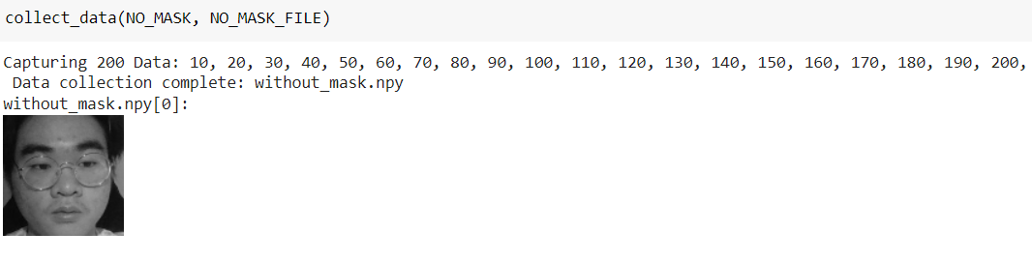
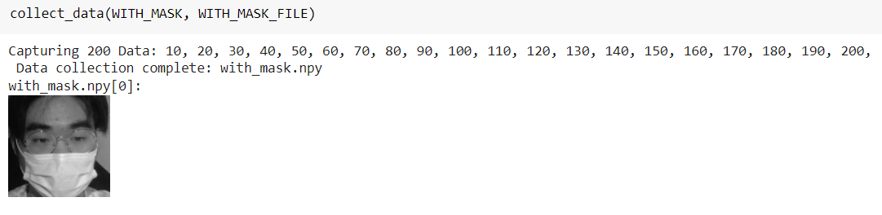
Description of Implementation

Slide 9
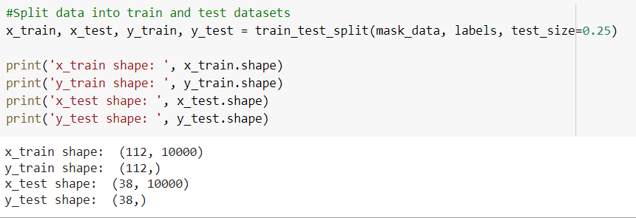
Description of Implementation
Data is then preprocessed to reduce image dimensions and then split into training and testing data

Slide 10
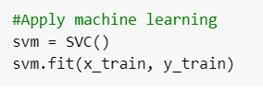
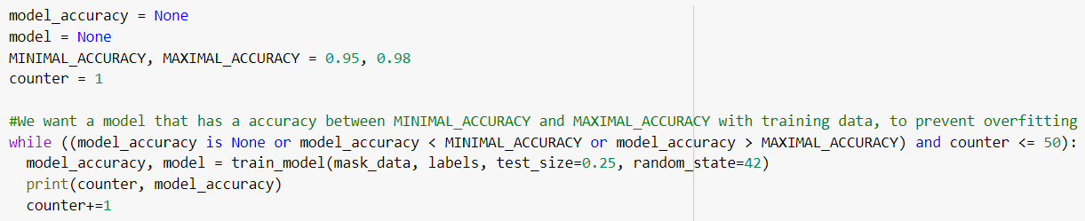
Description of Implementation
Finally a classifier is created to model and the model is trained using x_train and y_train training sets which contains 75% of the collected data.
However, in efforts to avoid overfitting, the model is trained until it is at max 98% accuracy or recreating the model 50 times. The accuracy is measured using the x_test and y_test, test sets.

Slide 11
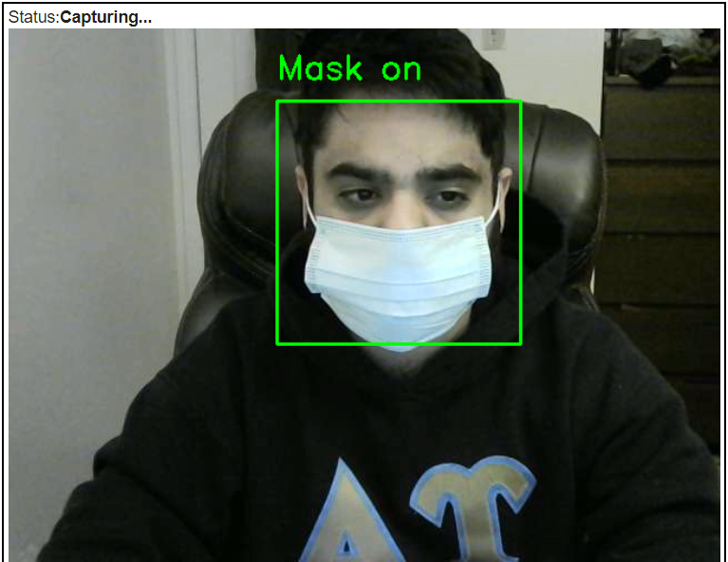
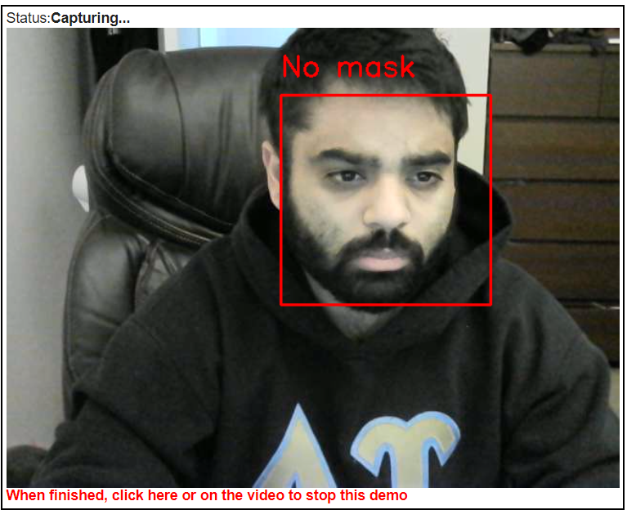
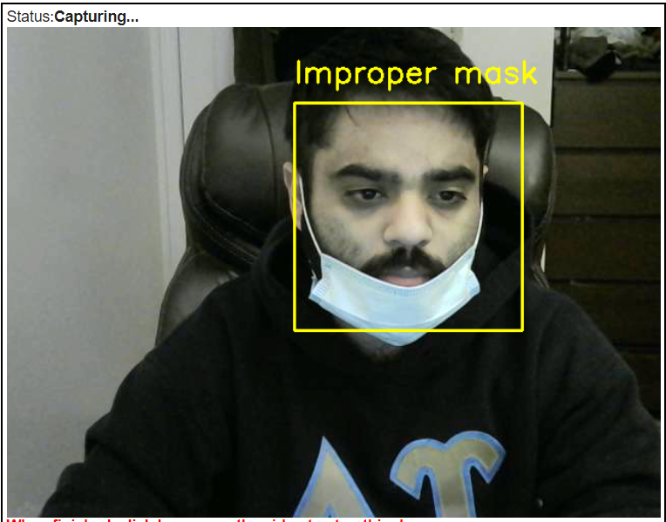

Slide 12
Conclusion
The model is designed to make sure that people are not necessarily exposed to the virus especially when they are following the rules and others are not.
The accuracy in a live test is great, however with a larger dataset, and training the model with multiple people in an image as well as varied selection of setting and masks (such as homemade masks), the model would perform better.

Slide 13
End
Thanks you for watching this presentation.

Slide 14
Team members and the Contribution Matrix
Team Members | Contribution Percentage
Connor Robertson | 30
Terry Darmawan Hosea | 40
Manmeet Choudhary | 30

Slide 15
References
https://opencv24-python-tutorials.readthedocs.io/en/latest/py_tutorials/py_objdetect/py_face_detection/py_face_detection.html
https://towardsdatascience.com/a-comprehensive-guide-to-convolutional-neural-networks-the-eli5-way-3bd2b1164a53
https://towardsdatascience.com/support-vector-machine-introduction-to-machine-learning-algorithms-934a444fca47

